Slide 1
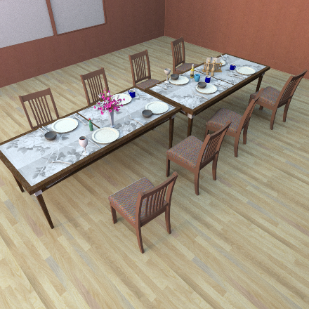
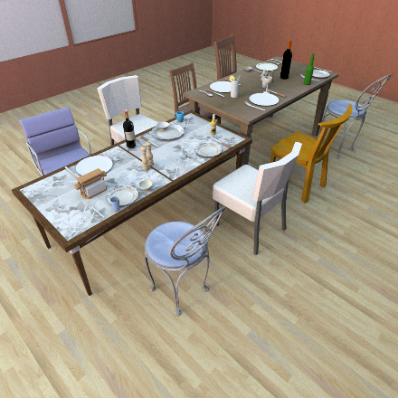
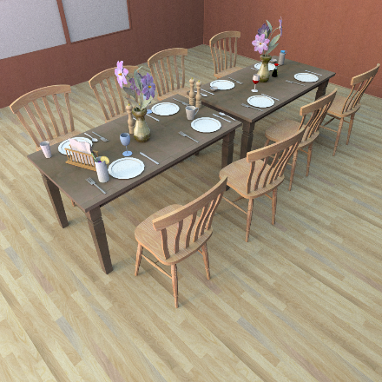
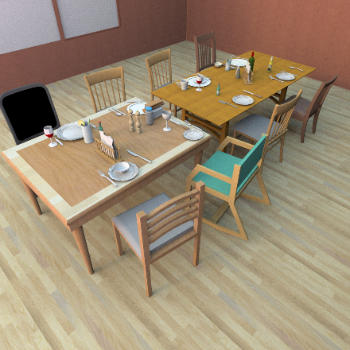
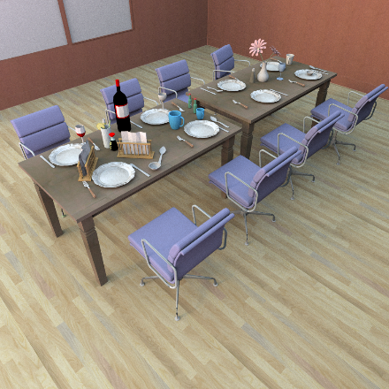
Activity-centric Scene Synthesis for Functional 3D Scene Modeling
Matthew Fisher
Manolis Savva
Yangyan Li
Matthias Niessner
Pat Hanrahan
Stanford University
November 3rd, 2015

Slide 2
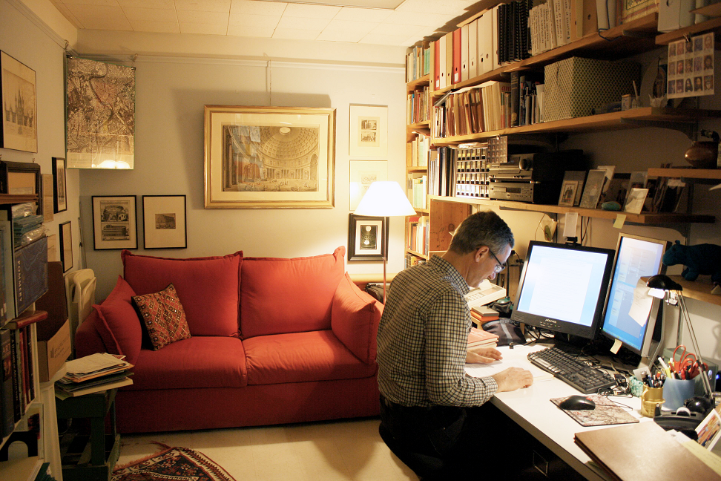
Human-made environments enable activities

Slide 3
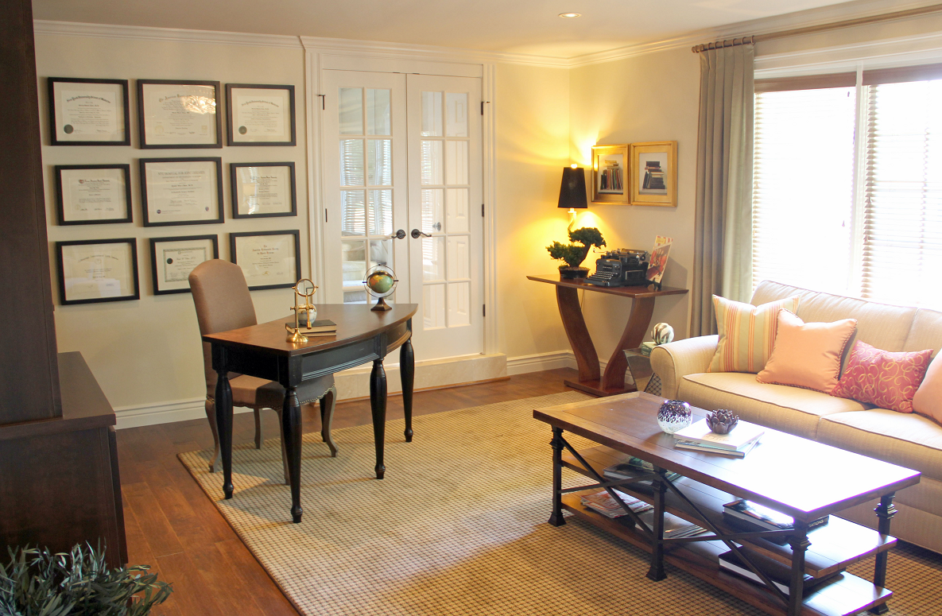
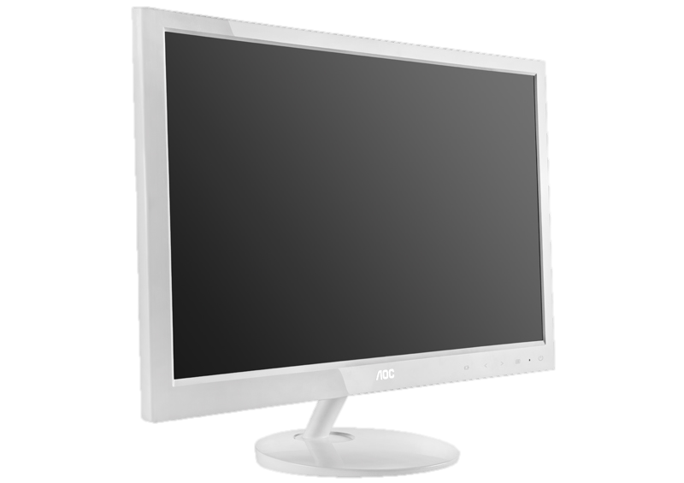
Where does the monitor go?

Slide 4
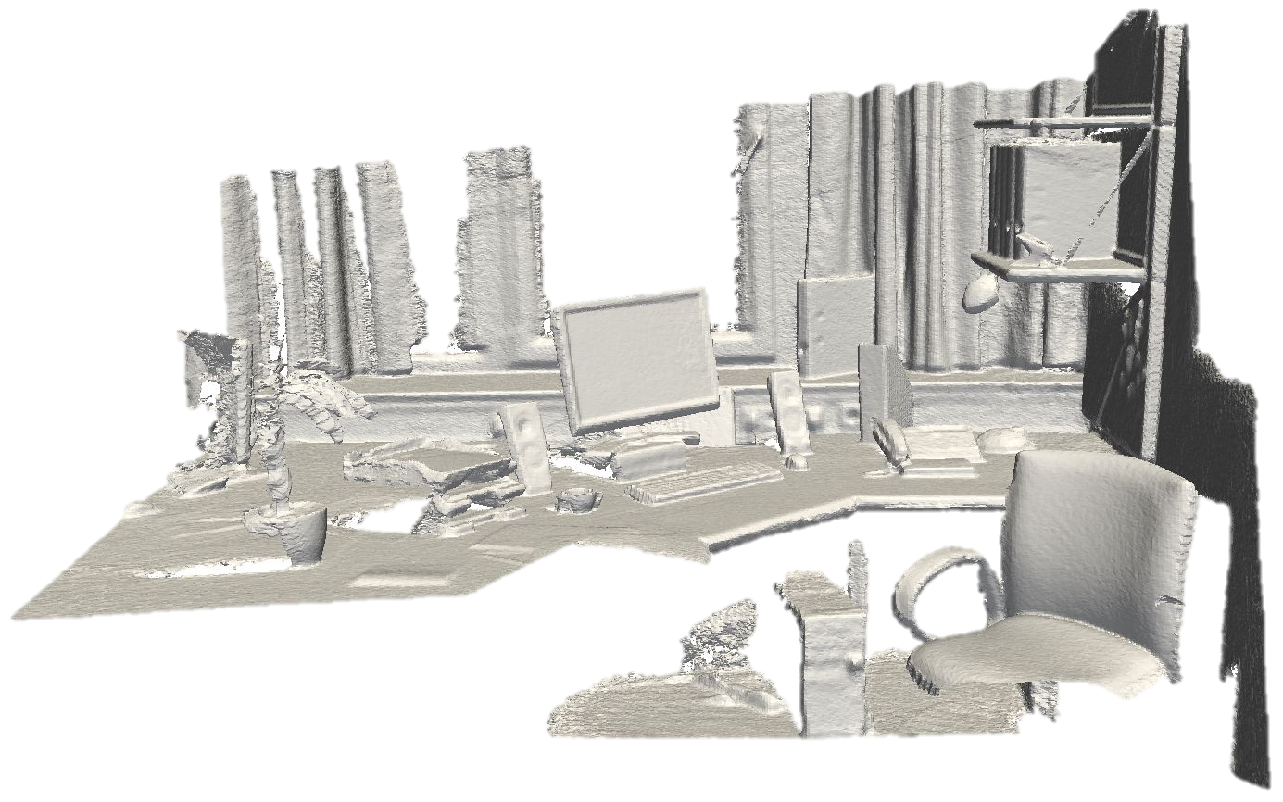
What is that?

Slide 5
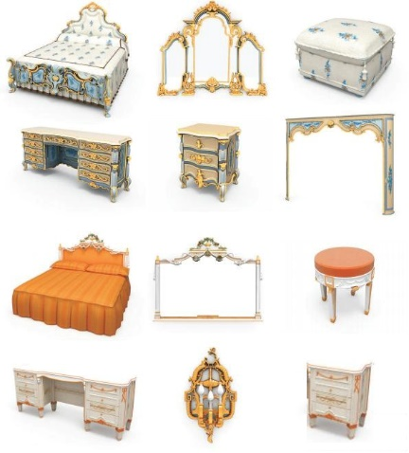
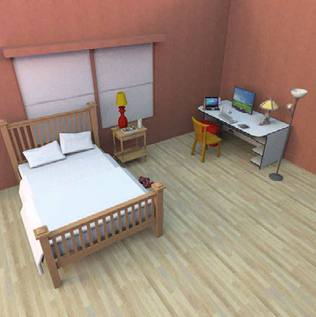
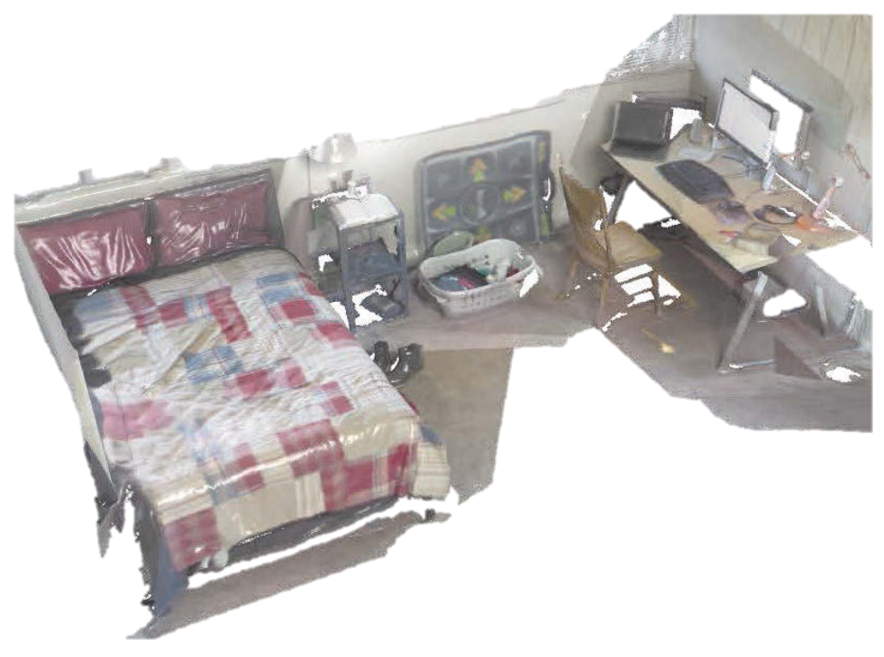
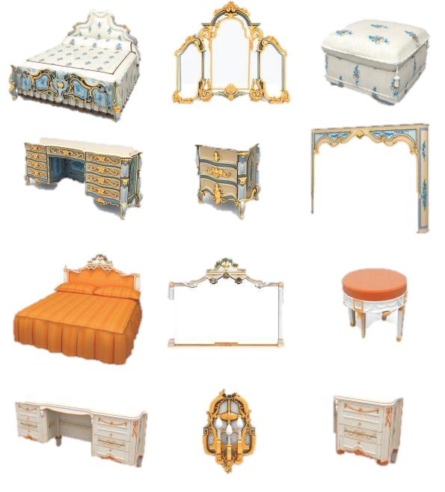
Scene modeling
Input depth scan
3D model corpus
Modeled scene

Slide 6
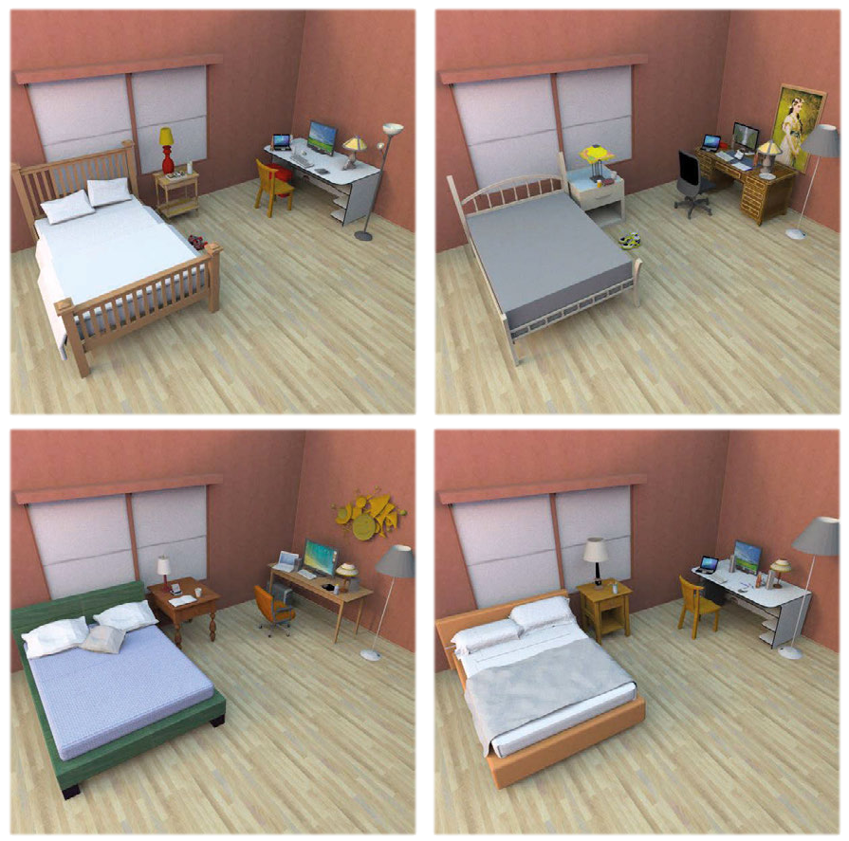
Scene modeling
Input depth scan
3D model corpus
Modeled scenes

Slide 7
Scene modeling challenges
Partial observations
Sensor resolution and noise
Geometric ambiguity

Slide 8
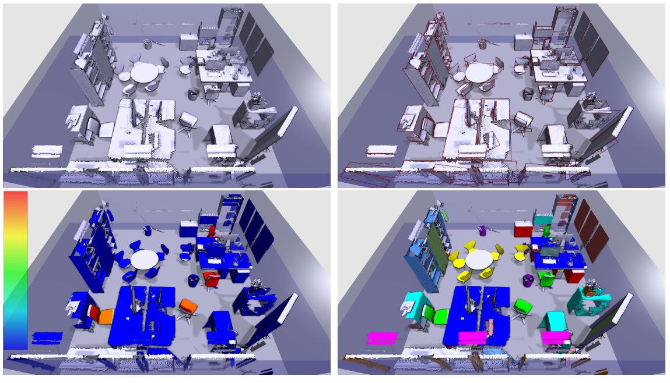
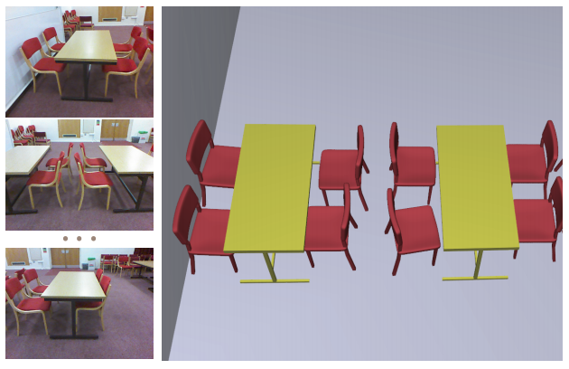
Geometric retrieval
Object Detection and Classification from Large-Scale Cluttered Indoor Scans. Oliver et al. 2014.
Automatic semantic modeling of indoor scenes from low quality RGB-D data using contextual information. Chen et al. 2014.
Notes:
Many approaches exist that try to detect and classify objects in 3D scans by aggregating local and global geometric features. But geometric approaches alone are not sufficient to produce plausible scenes. One goal of our work is to augment these methods with an understanding of activities to improve the reconstruction results.

Slide 9
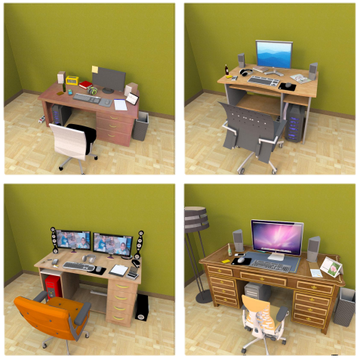
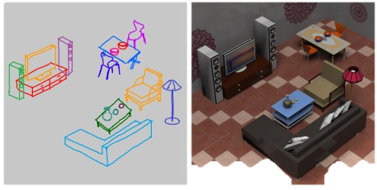
Scene synthesis
Example-based Synthesis of 3D Object Arrangements. Fisher et al. 2012.
Sketch2scene: Sketch-based co-retrieval and co-placement of 3d models. Xu et al. 2013.
Notes:
Our approach also builds heavily on prior work in scene synthesis, which tries to capture a distribution of plausible object arrangements. This distribution is then sample to generate 3D scenes. Our work additionally incorporates a notion of activities when modeling the distribution of plausible scenes.

Slide 10
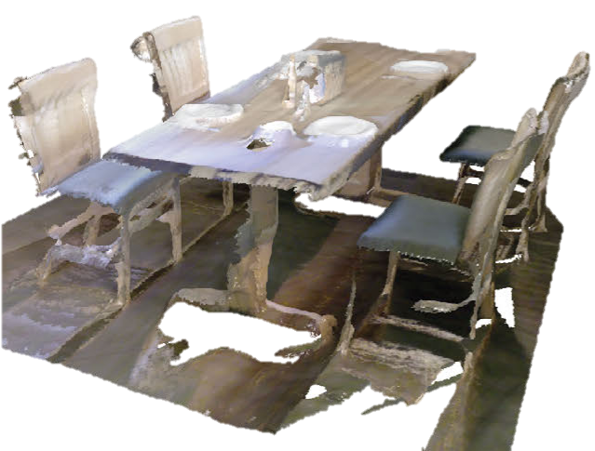
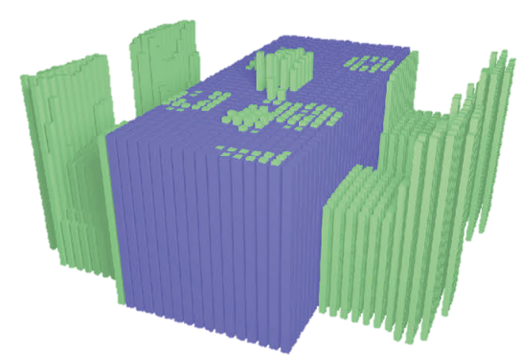
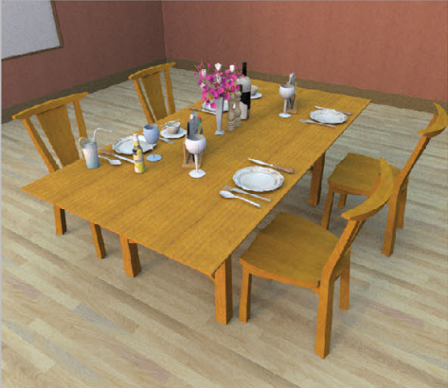
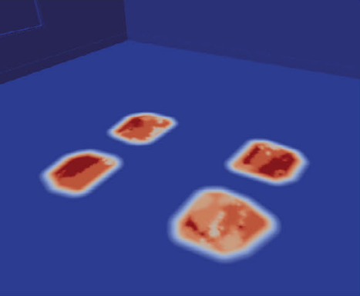
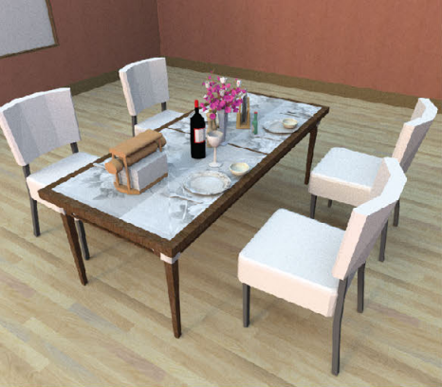
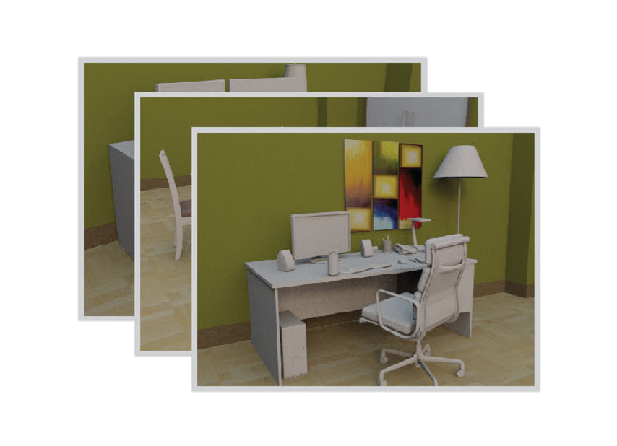
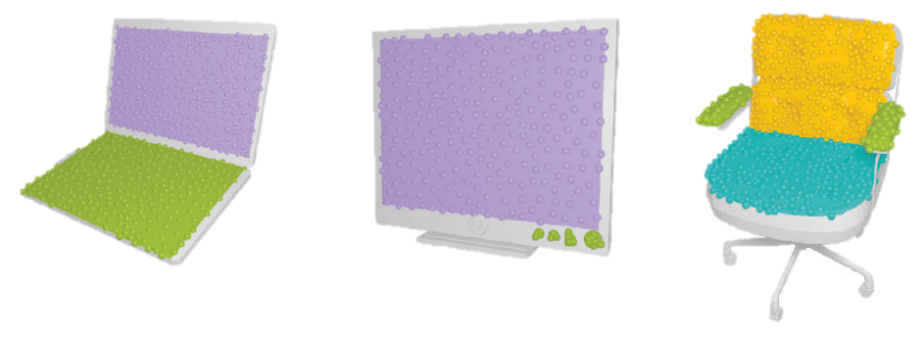
Our approach: Activity-centric scene synthesis
Geometric blueprint
Activity blueprint
Scene template
3D scan
Activity model
Scene synthesis
Activity-annotated scene database
Model interaction maps

Slide 11
Our approach: Activity-centric scene synthesis
Geometric blueprint
Activity blueprint
Scene template
3D scan
Activity model
Scene synthesis
Activity-annotated scene database
Model interaction maps

Slide 12
Activity model favors human-useable arrangements

Slide 13
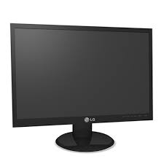
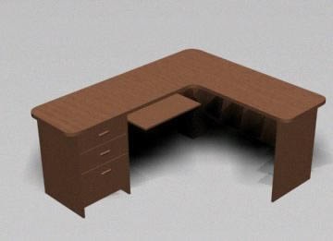
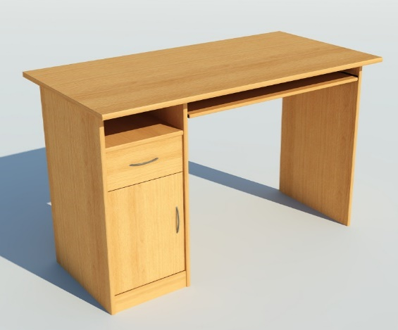
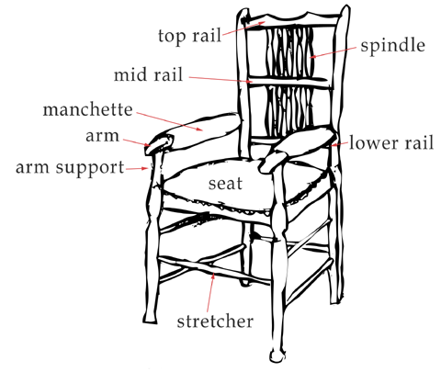
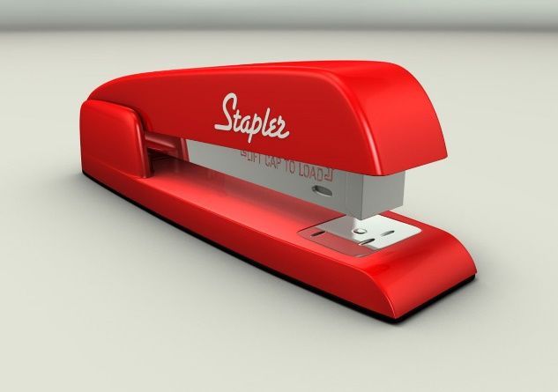
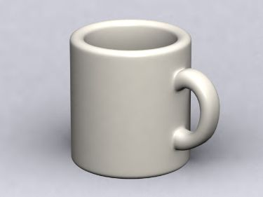
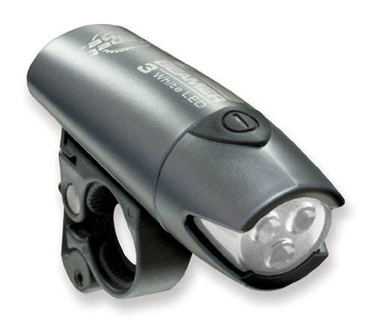
3D model databases
Trimble 3D Warehouse
ShapeNet
…

Slide 14
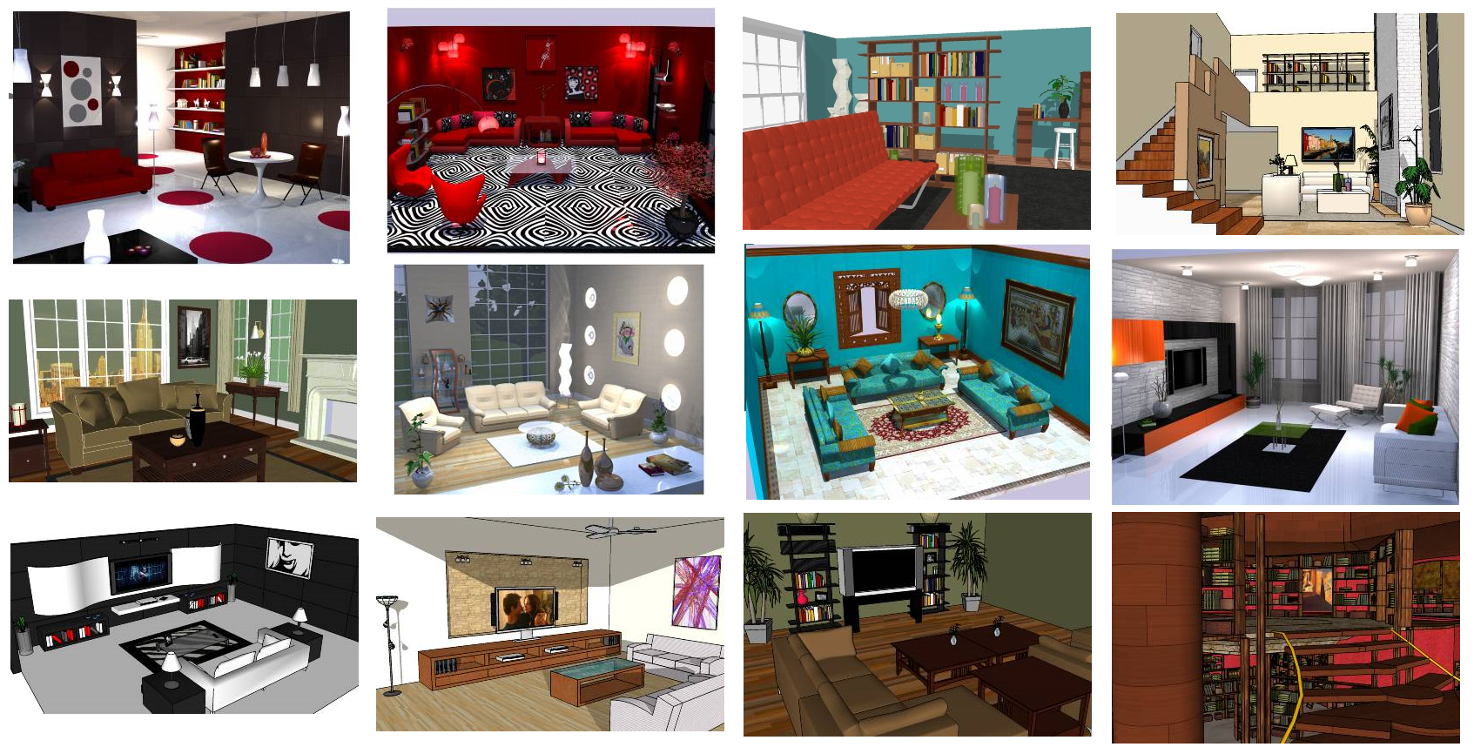
Activity model driven by 3D virtual scene database
Problem: no people!
Trimble 3D Warehouse
Stanford Scene Database
Washington RGB-D Scenes Dataset

Slide 15
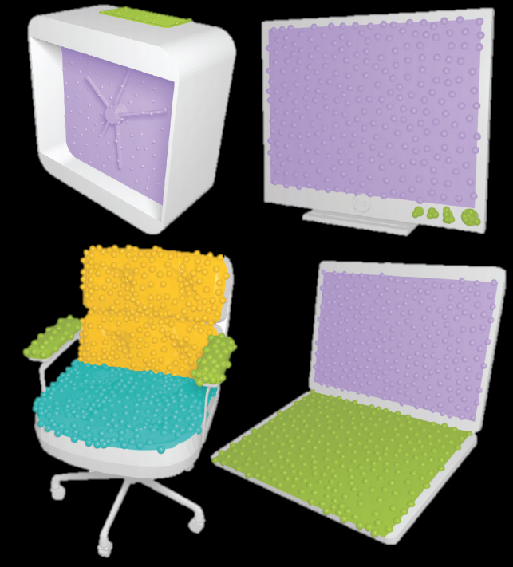
Annotation 1: Object interaction maps
Gaze interaction
Touch interaction
Back support
Hip support
Notes:
To fix this problem, we manually annotate our database with the desired activity knowledge.

Slide 16
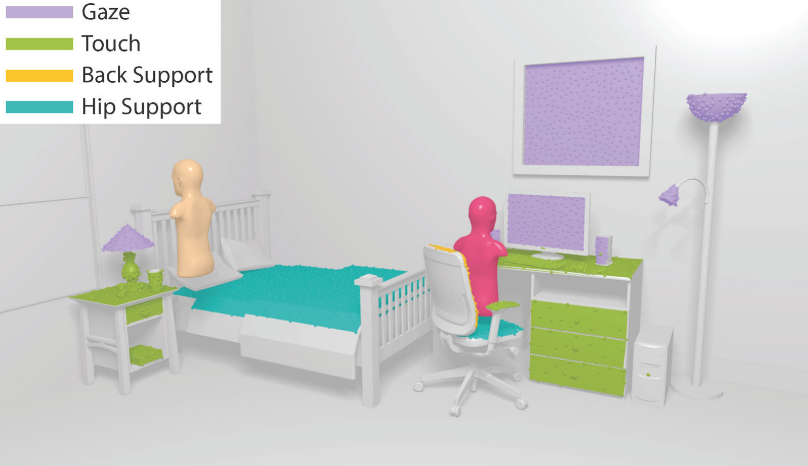
Annotation 2: Agent in scenes
Notes:
250 agents over 150 scenes.

Slide 17
Activity model
vs.
vs.
Object occurrence
Object interaction

Slide 18
Activity model
vs.
vs.
Object occurrence
Object interaction

Slide 19
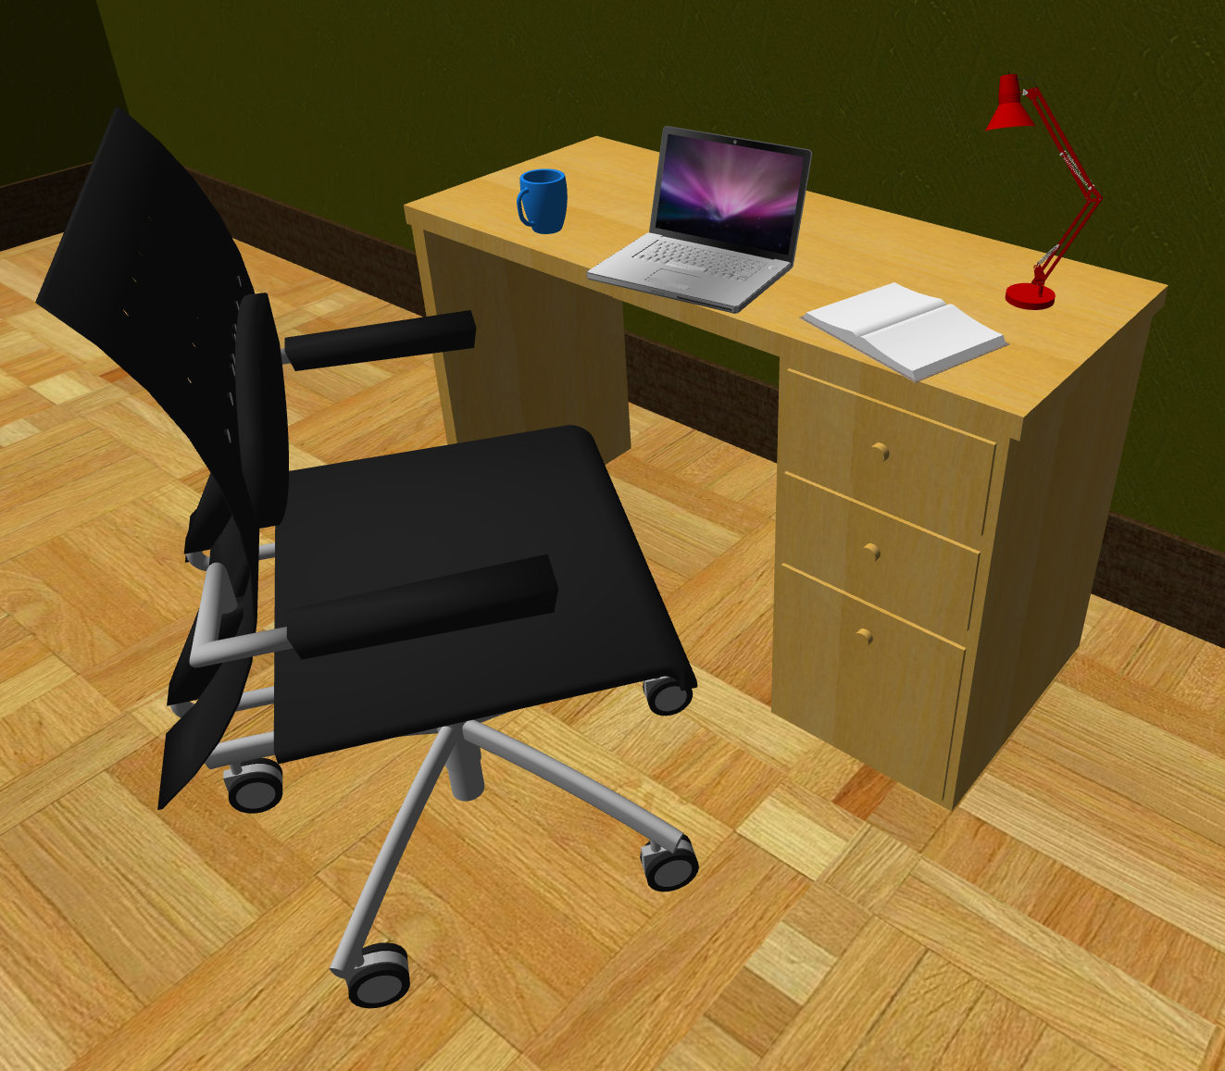
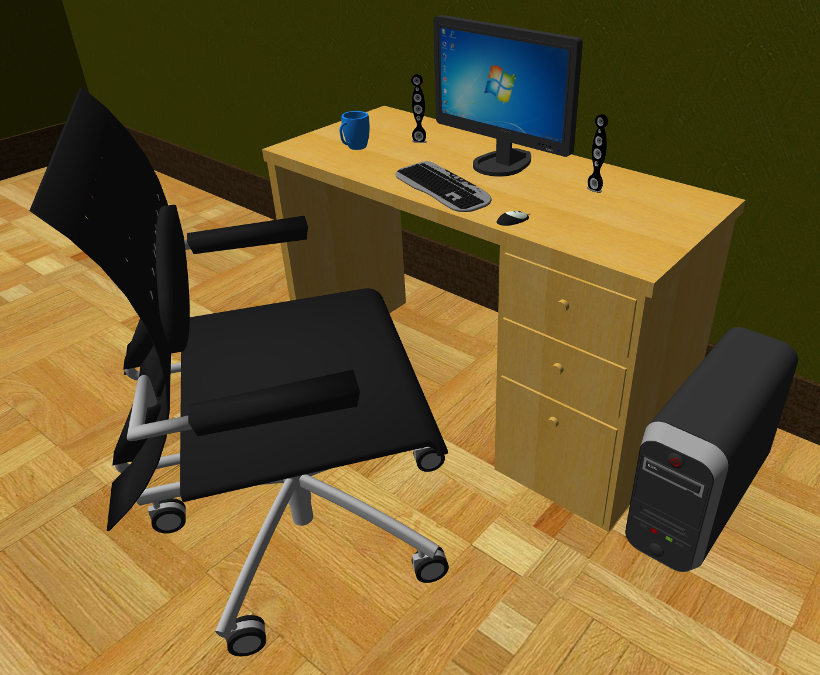
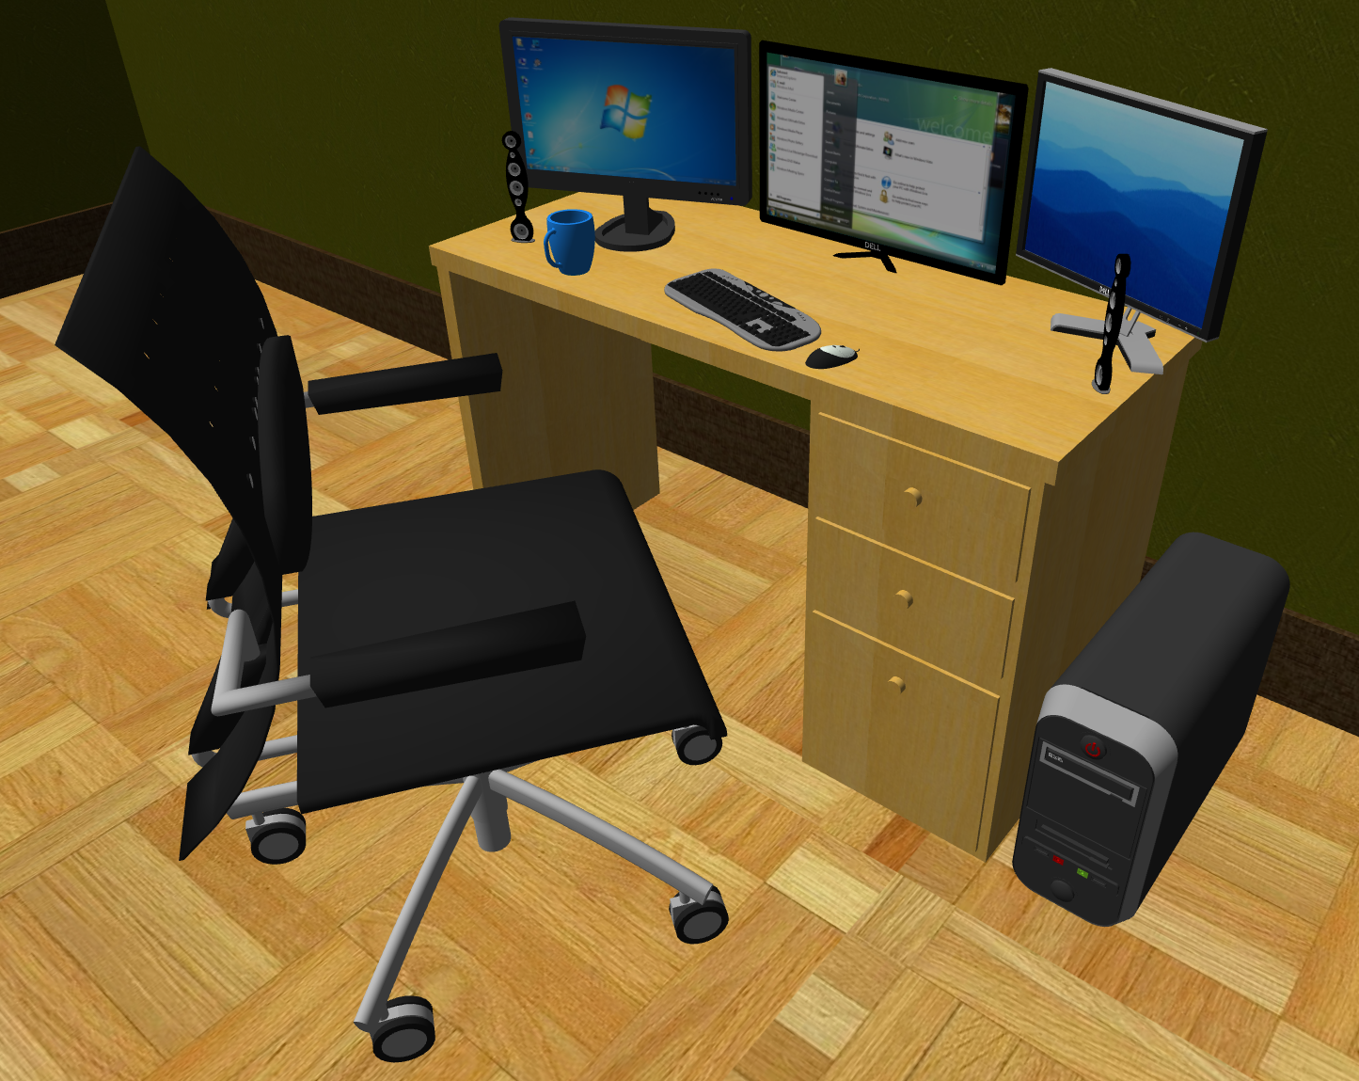
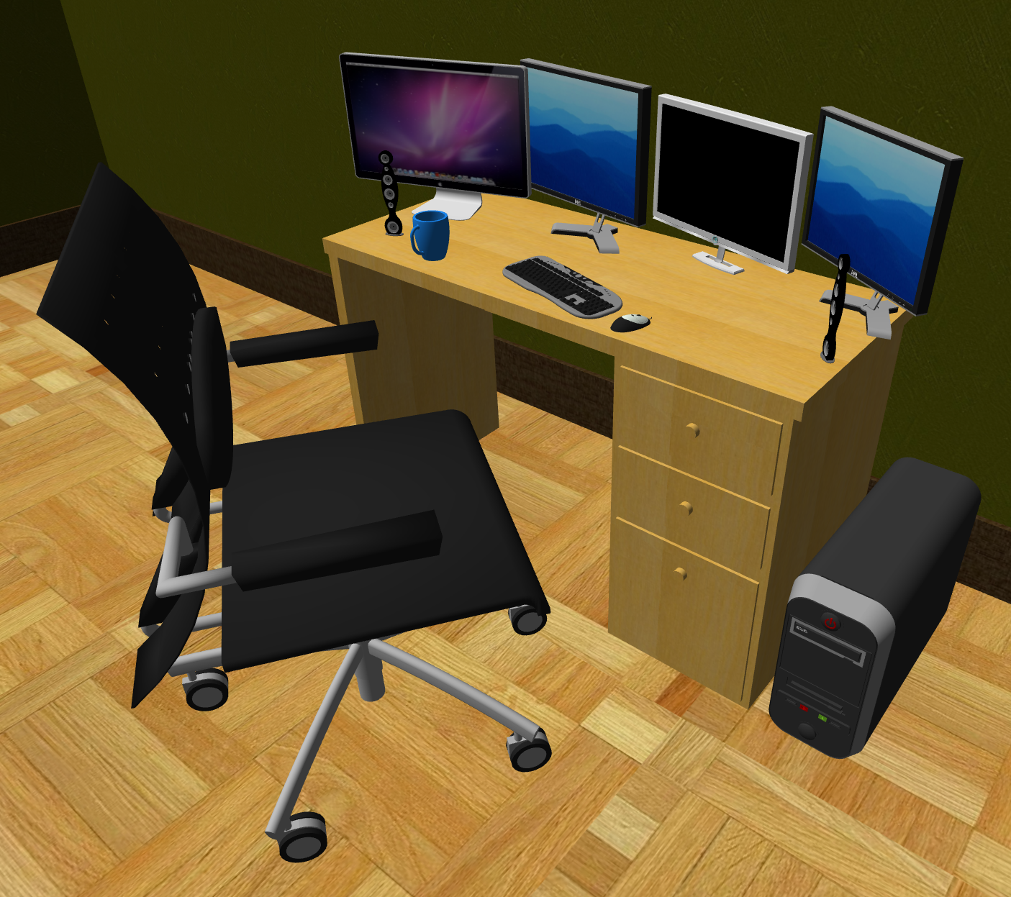
Object occurrence model
0 monitors
1 monitor
…
3 monitors
4 monitors
“How likely is a given number of monitors on a computer desk?”

Slide 20
Object occurrence model
Desk | Monitor | Keyboard | Laptop | Mug | Notepad
1 | 2 | 1 | 0 | 1 | 1

Slide 21
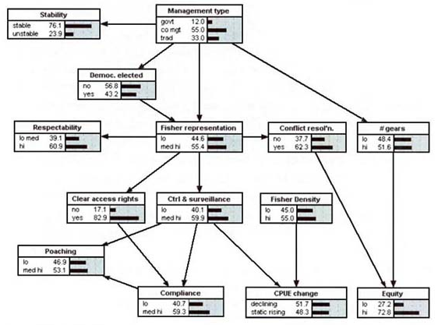
Object occurrence model
Desk | Monitor | Keyboard | Laptop | Mug | Notepad
1 | 2 | 1 | 0 | 1 | 1
1 | 1 | 1 | 0 | 0 | 1
1 | 1 | 1 | 0 | 0 | 0
1 | 0 | 0 | 1 | 2 | 0
Bayesian network via structure learning
Example-based Synthesis of 3D Object Arrangements. Fisher et al. 2012.

Slide 22
Activity model
vs.
vs.
Object occurrence model
Object interaction model

Slide 23
Object interaction model
Gaze interaction
Touch interaction
Back support
Hip support
Notes:
The object interaction model assigns high probability to objects if a human can use them. For example, a human must be able to see a TV and touch a keyboard. To estimate this probability, we use the object interaction maps defined over each model in our database.

Slide 24
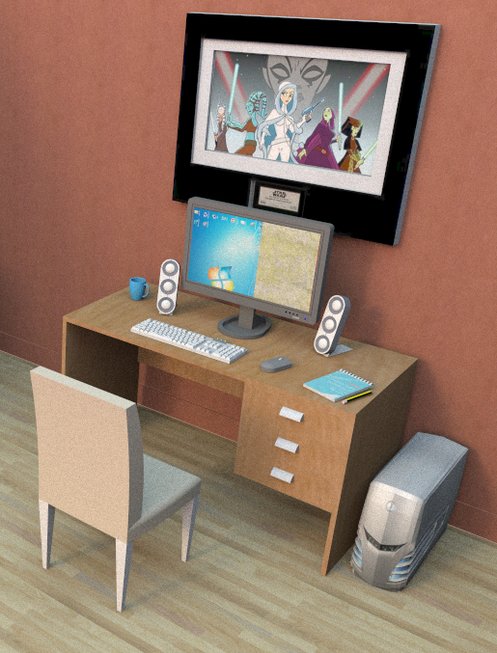
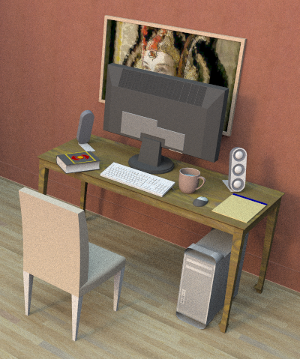
Gaze interaction map
High probability
Low probability
Notes:
For instance, here we show an example of the gaze interaction. Our model assigns a much higher likelihood to the arrangement on the left, because the monitor and poster are both visible to an agent sitting in the chair.

Slide 25
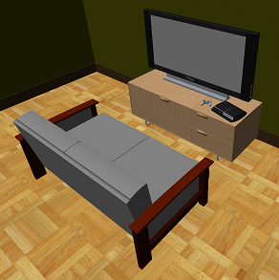
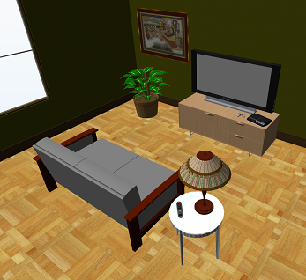
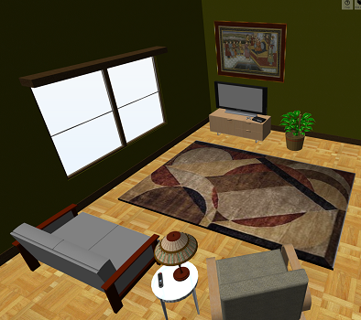
Gaze interaction distance distribution
Annotated scene database
Low probability
High probability
Low probability
“How likely is the observed agent to television gaze distance?”

Slide 26
Our approach
Geometric blueprint
Activity blueprint
Scene template
3D scan
Activity model
Scene synthesis
Activity-annotated scene database
Model interaction maps

Slide 27
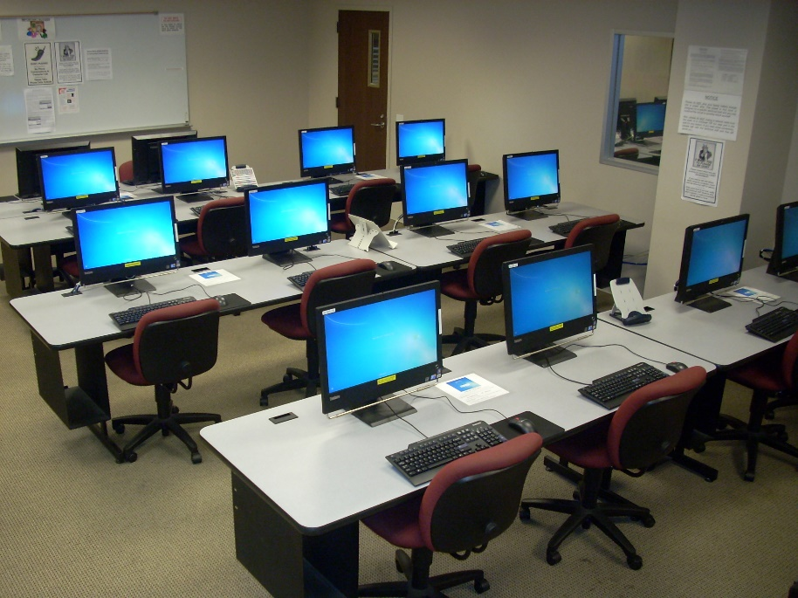
Scene template
A rough description of:
The geometric layout of a scene (“floor plan”)
Where different activities take place in the scene (“activity plan”)
Use desktop PC
Use whiteboard

Slide 28
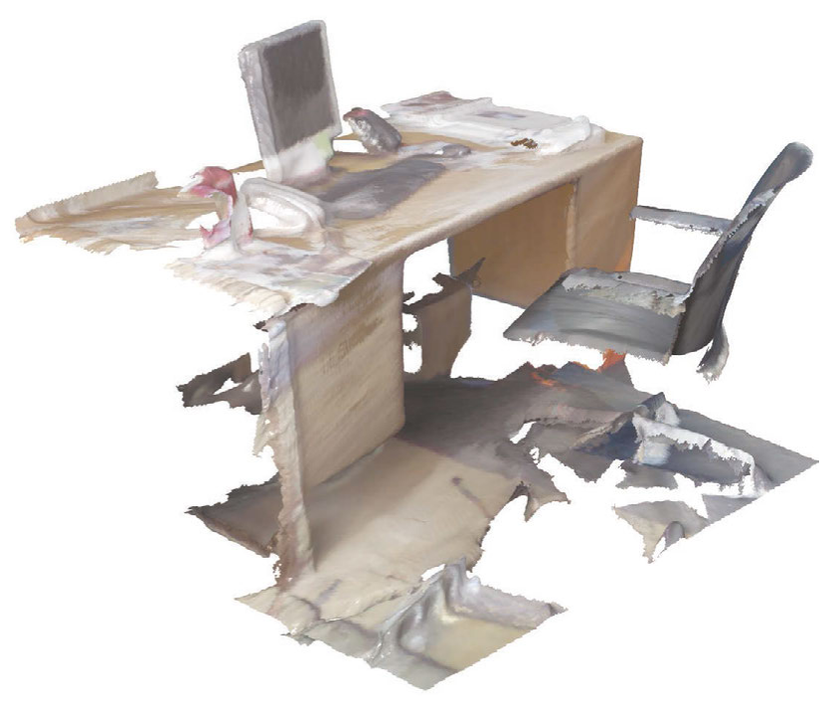
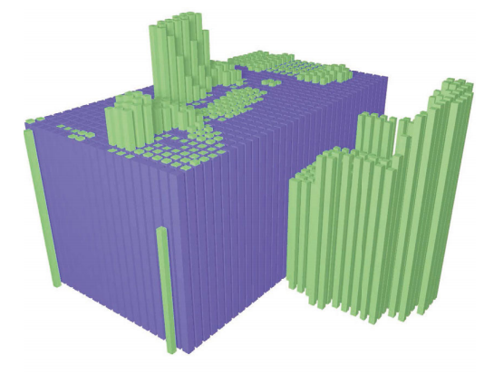
Geometric blueprint
Object detection and classification from large-scale cluttered indoor scans. Mattausch et al. 2014.
Notes:
We extract the geometric blueprint from the scan by using a plane extraction approach designed for object detection and classification. The resulting blueprint encodes a global geometric model of the scan.

Slide 29
Activity blueprint

Slide 30
Activity blueprint
Eat at dining table

Slide 31
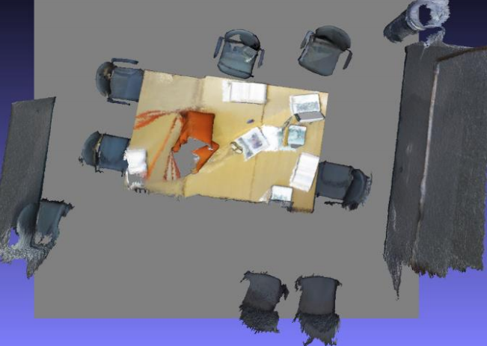
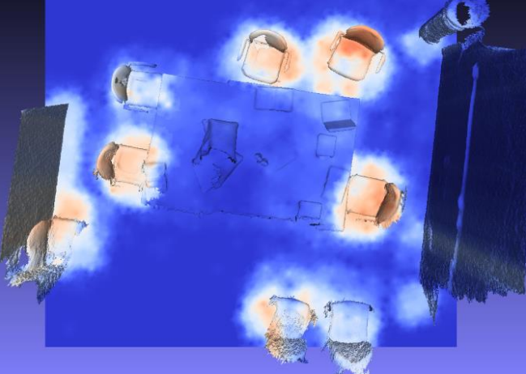

Activity blueprint
“sit at a table”
“use a whiteboard”
SceneGrok: Inferring Action Maps in 3D Environments. Savva et al. 2014.

Slide 32


Activity blueprint
Use desktop PC
Sit on couch
SceneGrok: Inferring Action Maps in 3D Environments. Savva et al. 2014.
Notes:
An action map is a statistical model for where different actions can occur in an environment. We extend this work and sample from the resulting action maps to produce localized, oriented agents such as the five shown here.

Slide 33



Scan to scene template
Geometric blueprint
Activity blueprint

Slide 34
Geometric blueprint
Activity blueprint
Scene template
3D scan
Activity model
Scene synthesis
Activity-annotated scene database
Model interaction maps

Slide 35








Synthesis pipeline
1 chair
2 monitors
1 desk
1 keyboard
1 mouse
2 speakers
…
…
Geometric blueprint
Sample objects from occurrence model
Repeatedly insert objects at plausible locations
Activity blueprint

Slide 36





Synthesis step
Geometric blueprint
Candidate A
Candidate B
Start configuration
Activity blueprint
Candidate C

Slide 37


Synthesis results

Slide 38












Synthesis results

Slide 39


Synthesis results

Slide 40












Synthesis results

Slide 41







Perceptual evaluation
…
Synthesis results (our method vs. Fisher et al. 2012)
…
Human-modeled scenes

Slide 42


Slide 43


Baseline comparison
Example-based Synthesis of 3D Object Arrangements. Fisher et al. 2012.

Slide 44

Notes:
By incorporating activities, our method performs significantly better than the baseline approach.

Slide 45


Limitation: Scene scale

Slide 46


Limitation: Localization of activities

Slide 47

Future directions

Slide 48
Learning interactions from observations

Slide 49


Generate scenes from text
“A medium-sized kitchen with a four-person dining table”
“A room with an entertainment center and a table for playing board games”
Learning Spatial Knowledge for Text to 3D Scene Generation. Chang 2014.

Slide 50

Data generation for machine learning
Convolutional neural networks
ImageNet Classification with Deep Convolutional Neural Networks.
Krizhevsky 2012.

Slide 51

Data generation for machine learning

Slide 52






Data generation for machine learning
…

Slide 53

Code and datasets
3D model database + action map annotations
3D scene database + agent annotations
Synthesis results + generation code
http://graphics.stanford.edu/projects/actsynth/

Slide 54




Questions?

